Slide 1
3-Way Controlled Robotic Vehicle
Embedded Systems
Design
Ailton Lopes – A72852
Nuno Afonso – A65354

Slide 2
Agenda
1- System Overview
2-System Configuration
3- Software Implementation
Robot system
Controller System
Desktop Application system
4- Final Results

Slide 3
System Overview

Slide 4
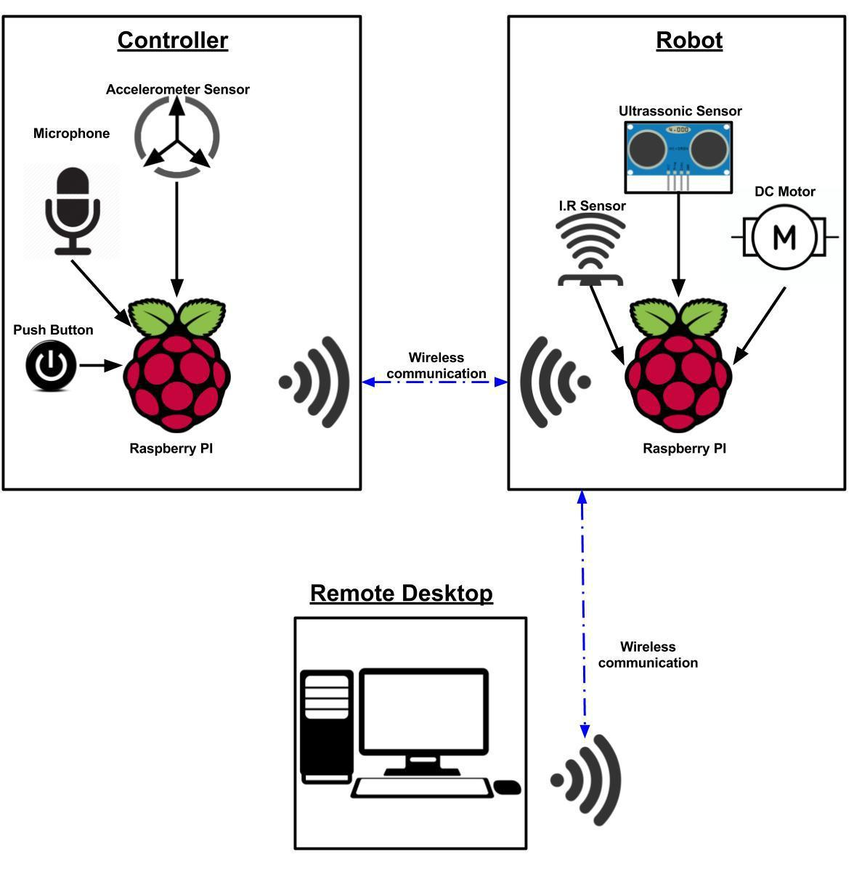

Slide 5
Functionalities:
Enables the user to Control the Robot system using motion
Enable user to control the robot System using the Desktop Application
Enables the user to control the Robot system using voice command
Detect the obstacle in the Direction of the movement
Alert the user when detected na obstacle in the movements direction
Gives to the user a feedback about the Robot State using the Desktop Application

Slide 6
System Configuration

Slide 7
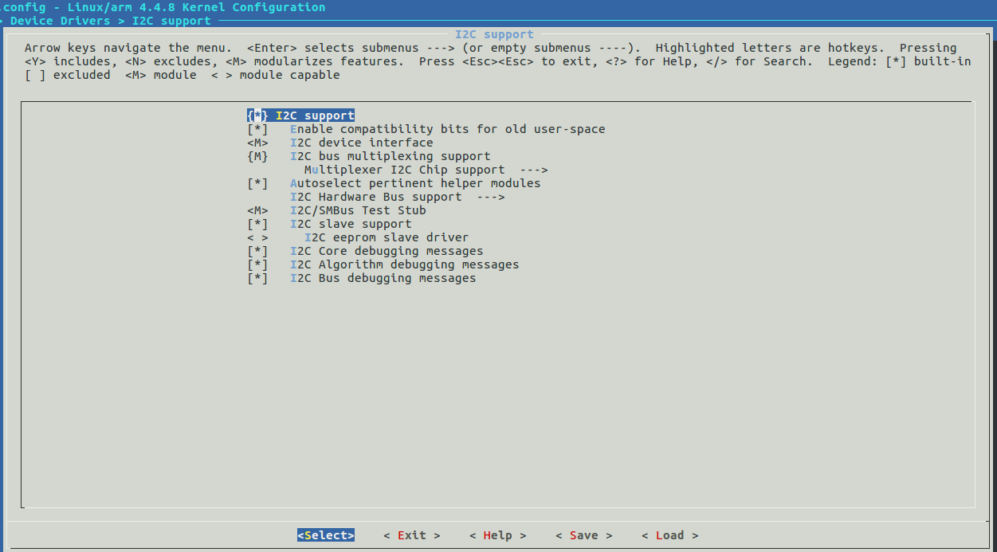
I2C

Slide 8
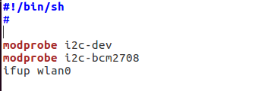
I2C
/etc/init.d

Slide 9
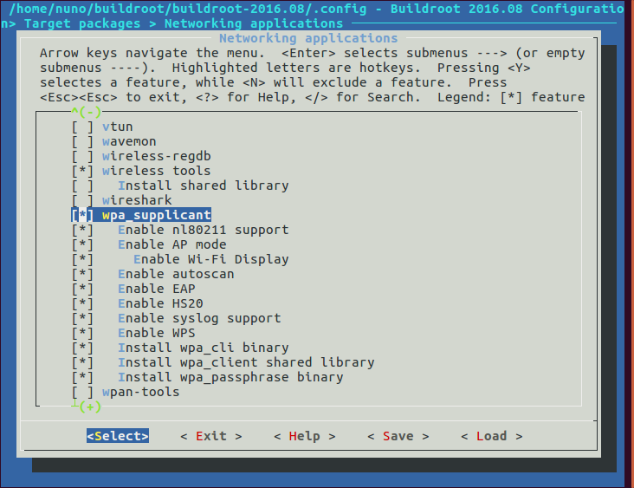
Wi-Fi Dongle Configuration

Slide 10
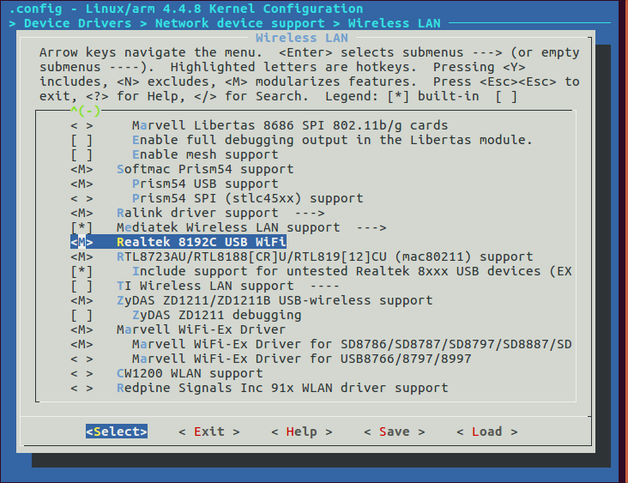
Wi-Fi Dongle Configuration

Slide 11
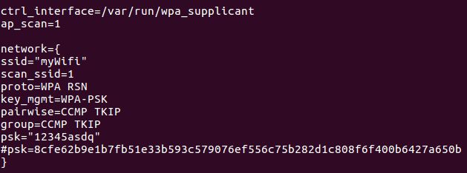
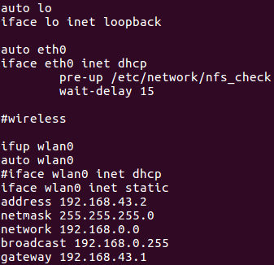

Wi-Fi Dongle Configuration

Slide 12
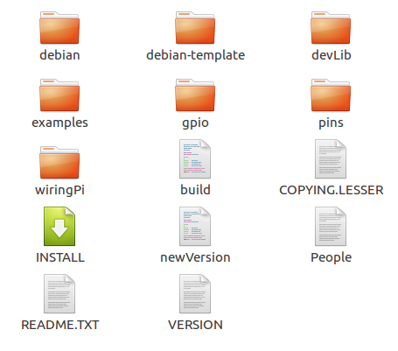
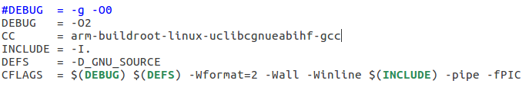
WiringPi

Slide 13
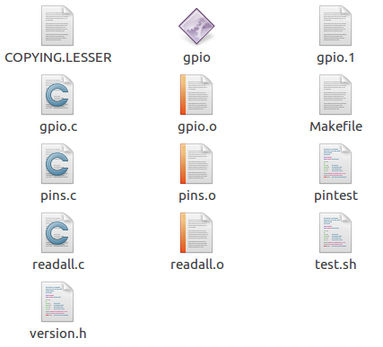
WiringPi

Slide 14
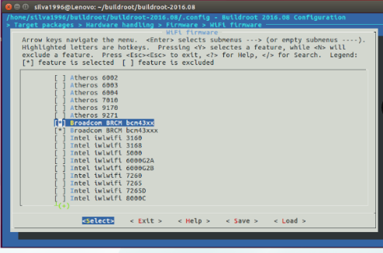
built-in Wi-Fi Card Configuration

Slide 15
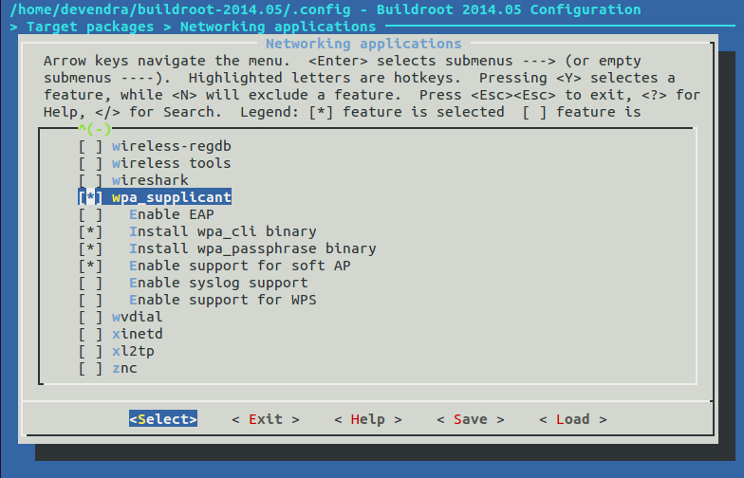
built-in Wi-Fi Card Configuration

Slide 16
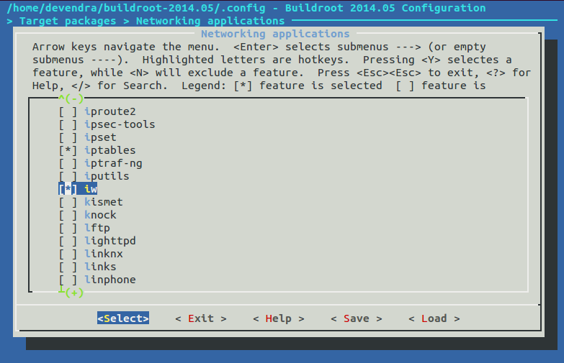
built-in Wi-Fi Card Configuration

Slide 17
built-in Wi-Fi Card Configuration
After having the SD card done download the firmware from the website https://github.com/RPi-Distro/firmware-nonfree/tree/master/brcm80211/brcm
Add it to the Raspberry pi

Slide 18
Speech Recognition Engine
Julius
Pocketsphinx
Google Speech API
Kaldi
libsprec

Slide 19
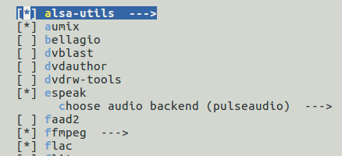

Pocketsphinx Dependences

Slide 20
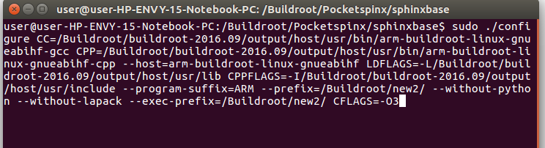
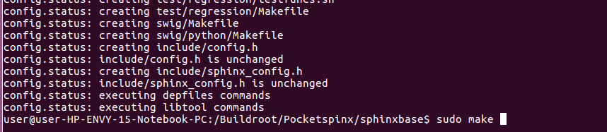
Pocketsphinx Configuration

Slide 21
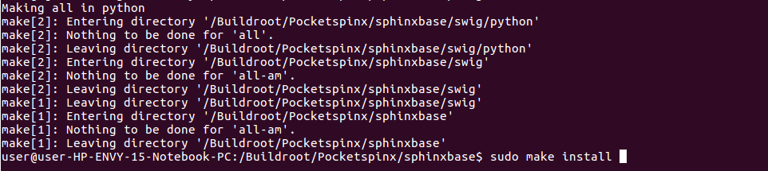
Pocketsphinx Configuration

Slide 22
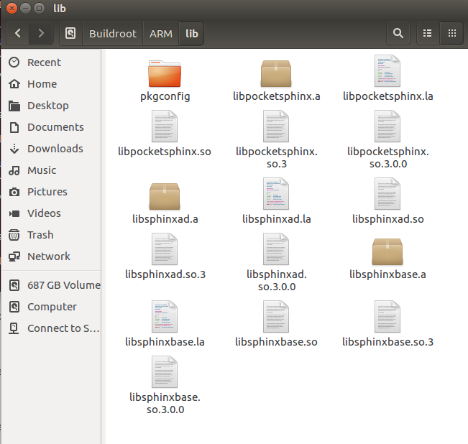
Pocketsphinx Configuration

Slide 23
Test Cases

Slide 24
Controller System
Accelerometer sensor
Microphone
Input | Expected Output | Output
$ sudo i2c-detect –y 1 | Accelerometer Slave Adress | “53”
Input | Expected Output | Output
$ cat /proc/asound/cards | Sound cards avalilable | 0 [Headset ]: USB-Audio - Logitech USB Headset Logitech Logitech USB Headset at usb-0000:00:02.0-8.2, full speed

Slide 25
Robot System
Buzzer sensor
Motors
Infrared Sensor
Input | Expected Output | Output
3.3V | Sound | sound
Input | Expected Output | Output
3.3V | movemments | Movemments
Input | Expected Output | Output
Hands in the Sensors Range | Trigger pin output High State | Trigger Pin output High State

Slide 26
Robot System
Ultrassonic Sensor
Input | Expected Output | Output
Hands in the Sensors Range | Ultrassound signal Echo

Slide 27
Software Implementation

Slide 28
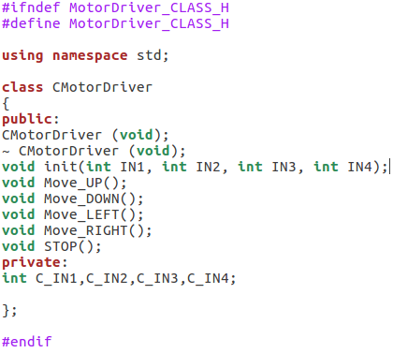
Robot
MotorDriver Class

Slide 29
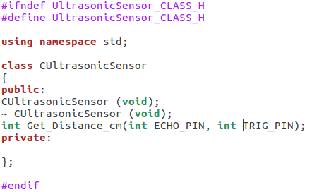
Robot
UltrassonicSensor Class

Slide 30
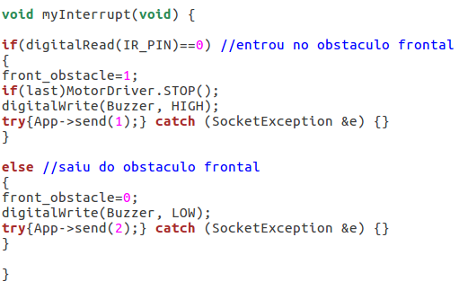
Robot
IR_Interrupt

Slide 31
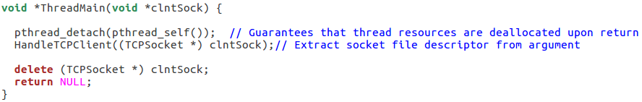
Robot
ThreadMain thread

Slide 32
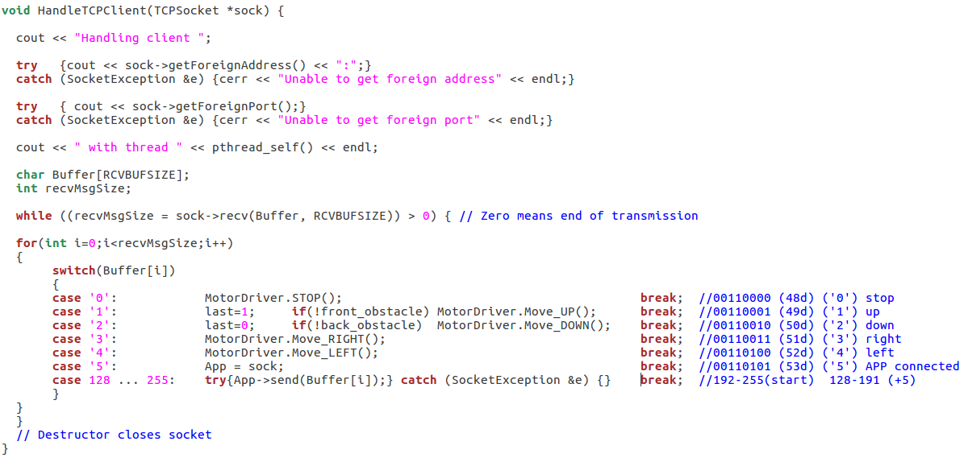
Robot
HandleTCPClient function

Slide 33
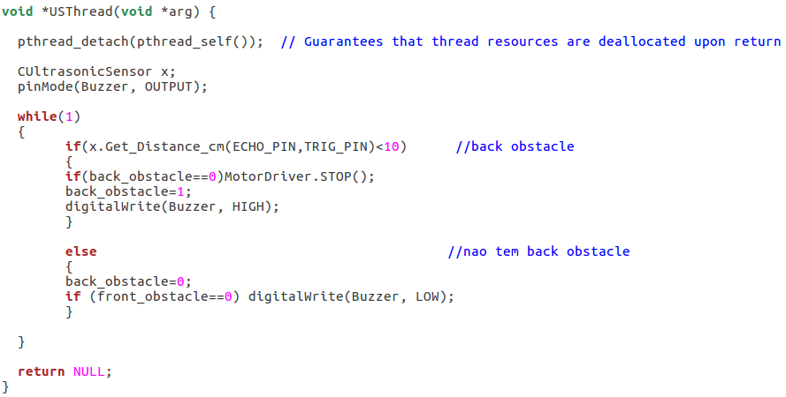
Robot
UltraSonic Sensor thread

Slide 34
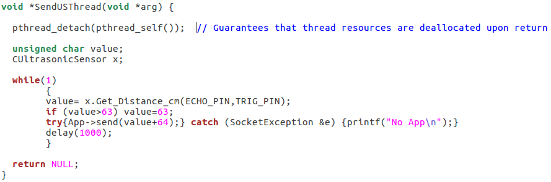
Robot
Send UltraSonic thread

Slide 35
Controller

Slide 36
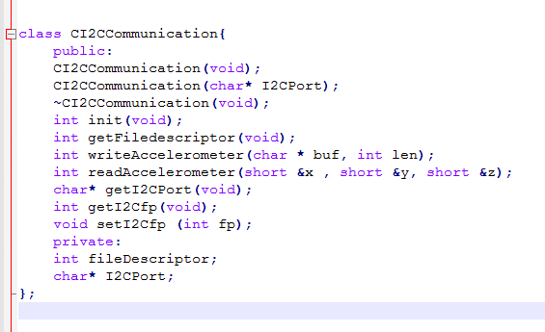
Controller
I2CCommunication class

Slide 37
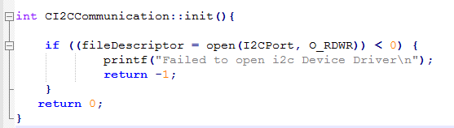
Controller
Init function

Slide 38
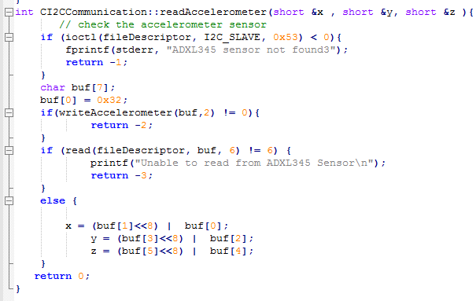
Controller
ReadAccelerometer function

Slide 39
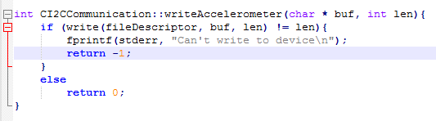
Controller
WriteAccelerometer function

Slide 40
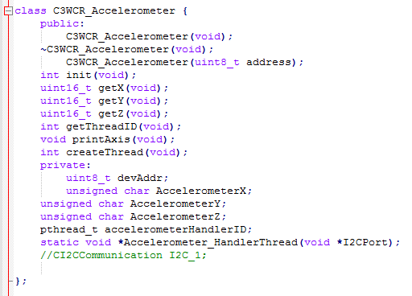
Controller
ADXL345 sensor class

Slide 41
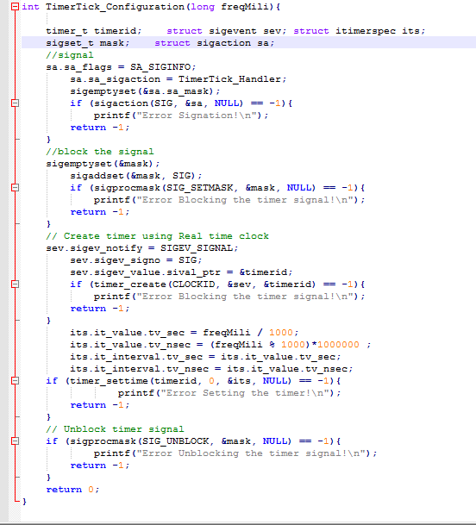
Controller
Timer Tick
function

Slide 42
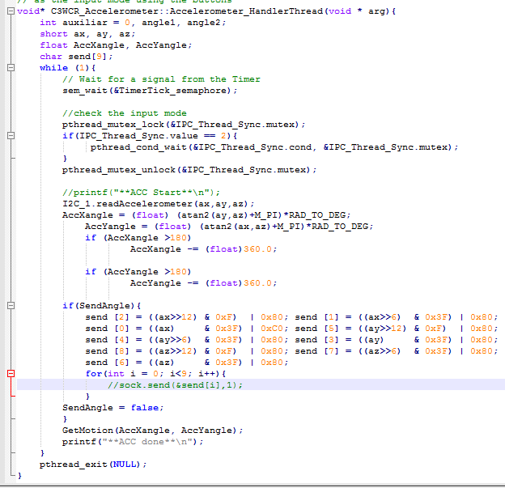
Controller
Accelerometer
Handler
thread

Slide 43
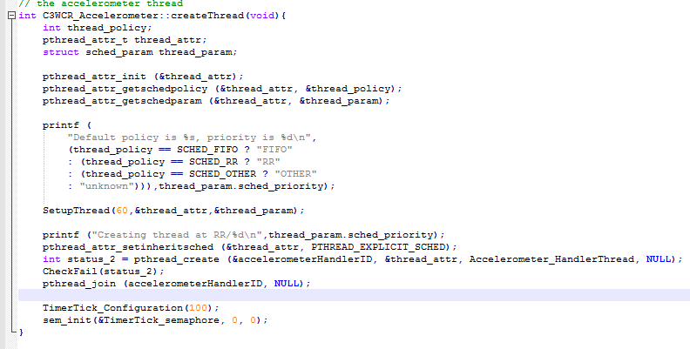
Controller
Create Thread function

Slide 44
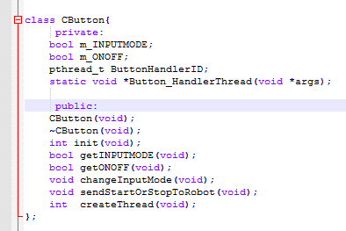
Controller
CButton Class

Slide 45
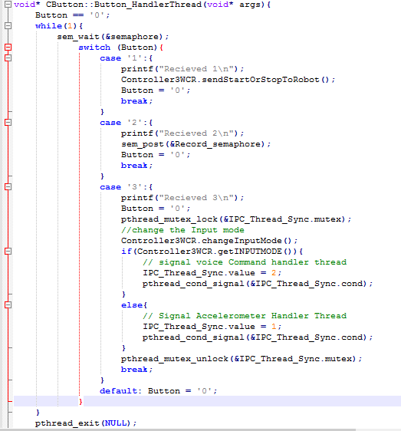
Controller
Button
Handler
Thread

Slide 46
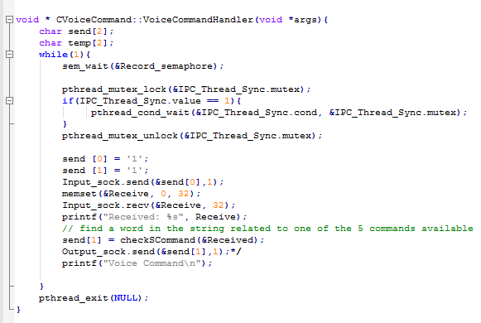
Controller
Voice Command Thread

Slide 47
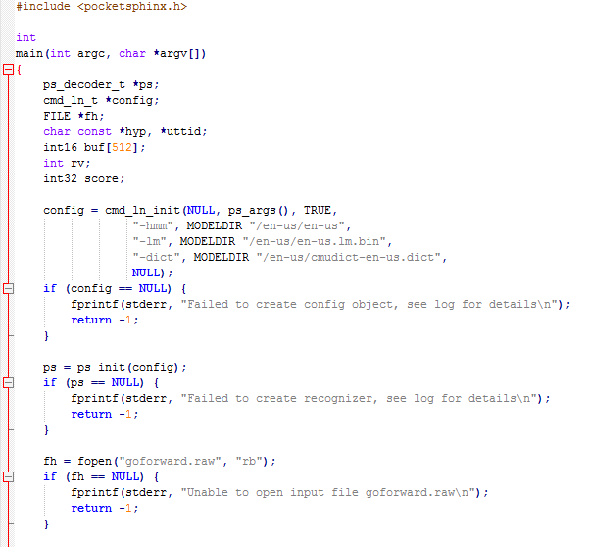
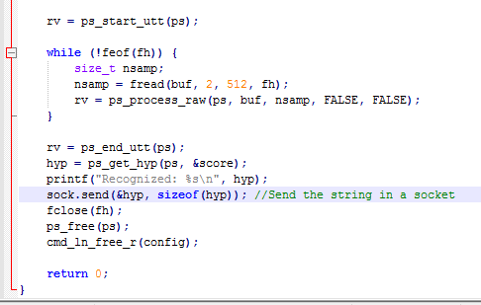
Controller
Recognition Function

Slide 48
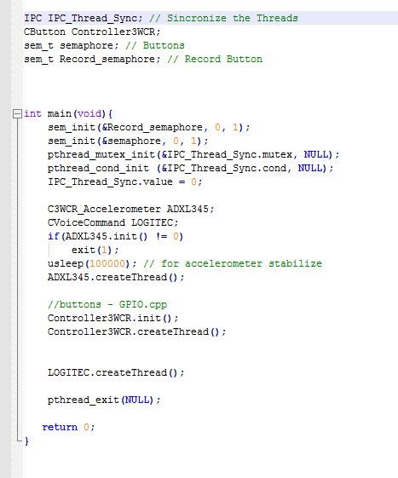
Main

Slide 49

Controller
Struct IPC

Slide 50
Desktop Application

Slide 51

Desktop Application
ConnectToHost function

Slide 52
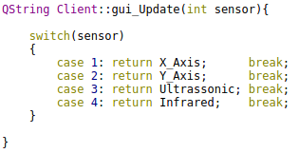
Desktop Application
GUI_Update function

Slide 53
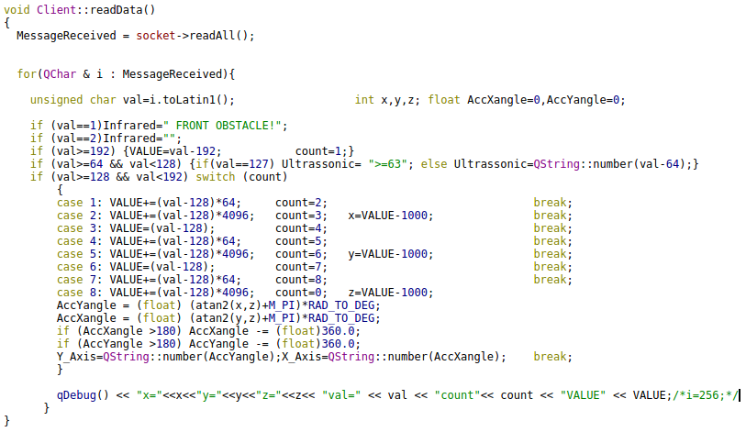
Desktop Application
ReadData function

Slide 54
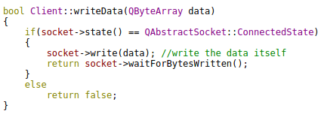
Desktop Application
WriteData function

Slide 55
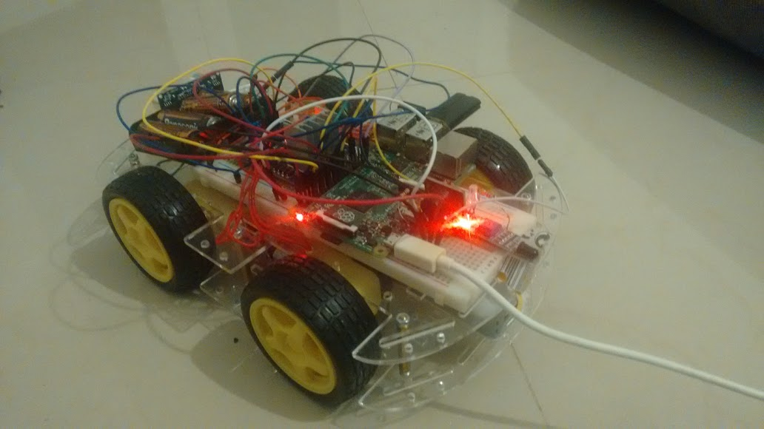
Robot Final Prototype

Slide 56
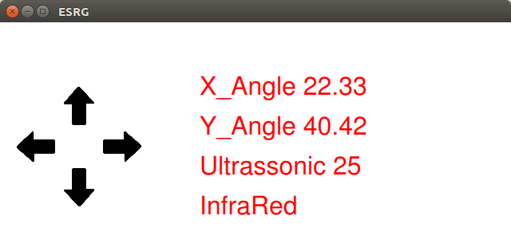
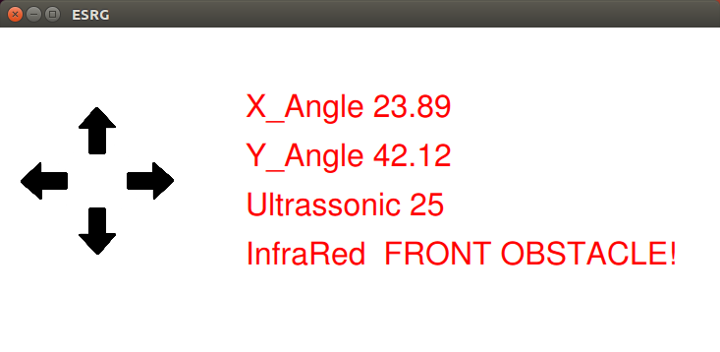
Desktop Application

Slide 57

Questions?

